Slide 1
Predictive Pricing Model for Short-Term Rental Properties: Empowering Property Owners in Antwerp, Belgium
Prepared & Presented by,
Hardik Khamankar
Sharon Vishnu Vijayan
Capstone Project Group 3
ABADS Batch 8B

Slide 2
Introduction
Project Objective:
Develop a machine learning-based solution to assist property owners in Antwerp, Belgium, for pricing their AirBnb rental properties.
Dataset Source:
The dataset comprises AirBnb listings available in Antwerp.
Key Steps Performed:
Data Understanding: Analyzed the dataset's structure and contents to gain insights into property attributes and rental prices.
Data Cleaning: Addressed missing values, outliers, and inconsistencies to ensure data quality.
Data Transformations: Prepared the dataset for modeling by encoding categorical variables and scaling numerical variables.
Data Quality Checks: Ensured the integrity and accuracy of the dataset through various validations.
Feature Engineering: Created aggregated datasets with predictor variables and the target variable (prices).
Assessed relationship between predictor variables and target variable using various methods.
Model Development: Implemented various predictive models using Linear Regression (OLS), Random Forest, Decision Tree etc to suggest listing prices based on property attributes.

Slide 3
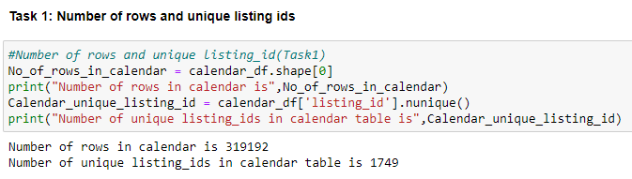
Task 1: Data Understanding & Feature Creation
Question:
Look at the table Calendar how many rows and unique listing ids are present? Are there any implications when it comes to having more rows and less unique listing ids?
In table Calendar, there are 319192 rows present with only 1749 unique listing IDs. From this data we can interpret the properties have been listed many times in Airbnb

Slide 4
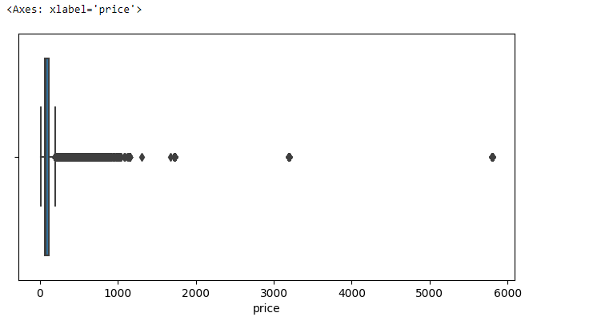
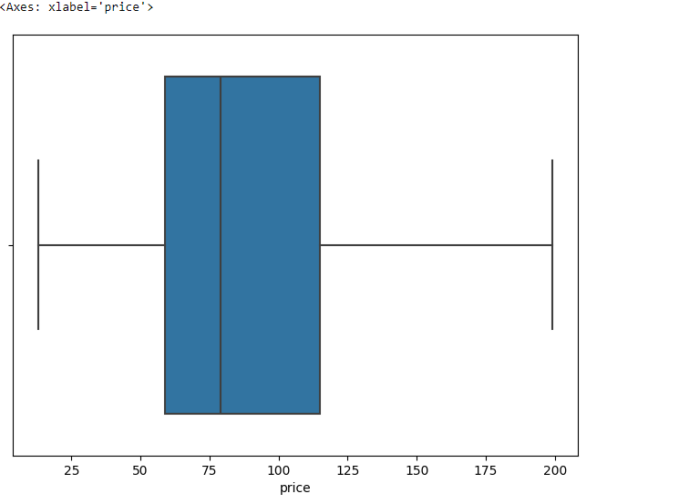
Task 1: Data Understanding & Feature Creation
Question:
Look at the price column in Calendar table. What transformations you will need to perform so that you can create a column that can be used as a target/response variable?
The column price had 75 null values. We used imputing with ‘mean’ for treating the null values.
Also, the analysis was showing outliers present in the price column data(above box plot). Outlier treatment was performed on the target variable using IQR method. Below is the box plot after outlier treatment.

Slide 5
Task 1: Data Understanding & Feature Creation
Question:
Look at the tables Listings, Hosts and Reviews to come up with a list of potential transformations needed in order to have predictors that can be used to predict the listing price.
The list of predictors selected are:
Calendar table : listing_id, date
Date columns required datatype change and converting the data from data- timestamp format to date format.
Listings table: property_type, room_type, accommodates, bedrooms & beds
No transformations were required for property_type, room_type and accommodates.
Columns bedrooms and beds had null values. Null value treatment was performed using imputation of mode values.
Also, outlier treatment was done on these 2 columns using Winsorization method after analysing the Data Quality Report.
Hosts table: None
Reviews table: None

Slide 6
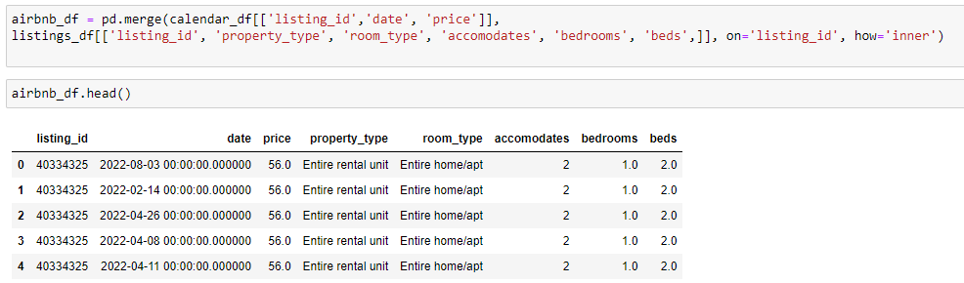
Task 1: Data Understanding & Feature Creation
Question:
Create an aggregated view of data spread across different tables, containing the target as well as predictor variables.
After identifying the predictor variables, an aggregated view is created which includes the predictor and target variables.

Slide 7
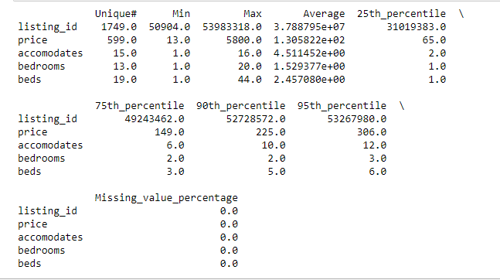
Task 1: Data Quality and Checks
Question:
Once the aggregated dataset has been created, do a data audit. Create a data quality report which has the following basic structure:
Part 1: Continuous Variables: (#unique values, percentage_missing_values, min, max, average, 25th percentile, 75th percentile, 90th percentile, 95th percentile)

Slide 8

Task 1: Data Quality and Checks
Question:
Once the aggregated dataset has been created, do a data audit. Create a data quality report which has the following basic structure:
Part 2:
Categorical Variables: (#Unique values, percentage_missing_values)

Slide 9
Task 1: Data Quality and Checks
Question:
Once the aggregated dataset has been created, do a data audit. Create a data quality report which has the following basic structure. Highlight any data anomaly that you find and fix it.
During earlier analysis, it was noticed that after merging, the data is having duplicate values (same listing_ids with same price on different dates). They are removed.
Bedrooms column is having an average ~ 1.5 and 95th percentile value of 3. But the Max value is 20 . This shows the presence of outliers. Winsorization method of Outlier treatment is performed considering the lower percentile value as 0.05 and upper percentile value as 0.95 percentile.
Beds column having an average ~2 and the 95th percentile value of 6. But the Max value is 44. Winsorization method of Outlier treatment is performed considering the lower percentile value as 0.05 and upper percentile value as 0.95 percentile.

Slide 10
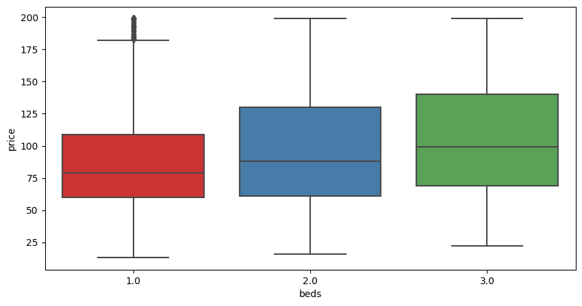
Task 2:Variable profiling and checking relationships between variables
Relationship between beds and price
Null Hypothesis: There is no correlation between beds and price.
Beds Pearson Correlation Coefficient with price is 0.17774021609424775, which is positive implies that with increase in beds, there might be an increase of price as well. But the correlation is a weak one.
The P-value is 2. 7144439754725076e -64 which is extremely close to zero, hence rejects the null hypothesis

Slide 11
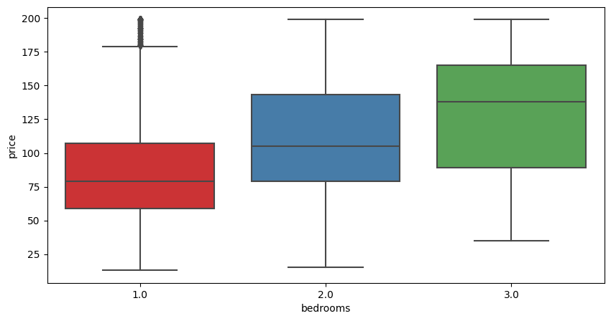
Task 2:Variable profiling and checking relationships between variables
Relationship between bedrooms and price
Null Hypothesis: There is no correlation between bedrooms and price.
Bedrooms Pearson Correlation Coefficient with price is 0.30184347550625806 is also positive and stronger than the beds - price one. This suggests that price tends to increase with increase with the increase in bedrooms
The P-value is ~ 1. 6640772691628812e -187 which is extremely close to zero, hence rejects the null hypothesis

Slide 12
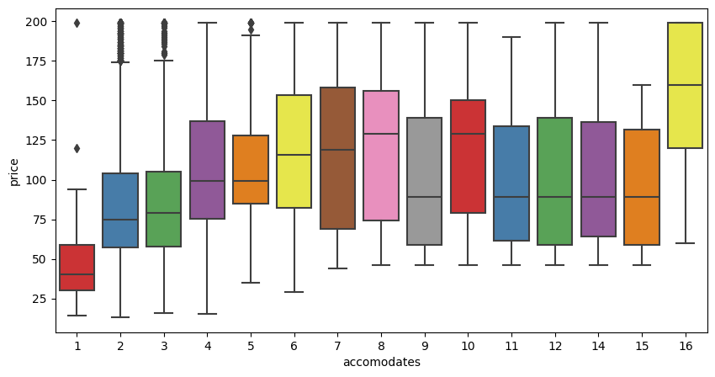
Task 2:Variable profiling and checking relationships between variables
Relationship between accomodates and price
Null Hypothesis: There is no correlation between accomodates and price.
Accommodates Pearson Correlation Coefficient with price is 0.15773582374687234, ehich is positive. So with increase with accomodates, there are chances that the price should increase. But this has the weakest correlation amongst the three variables.
The P-value is ~ 7.503508302739632e-51 which is extremely close to zero, hence rejects the null hypothesis

Slide 13
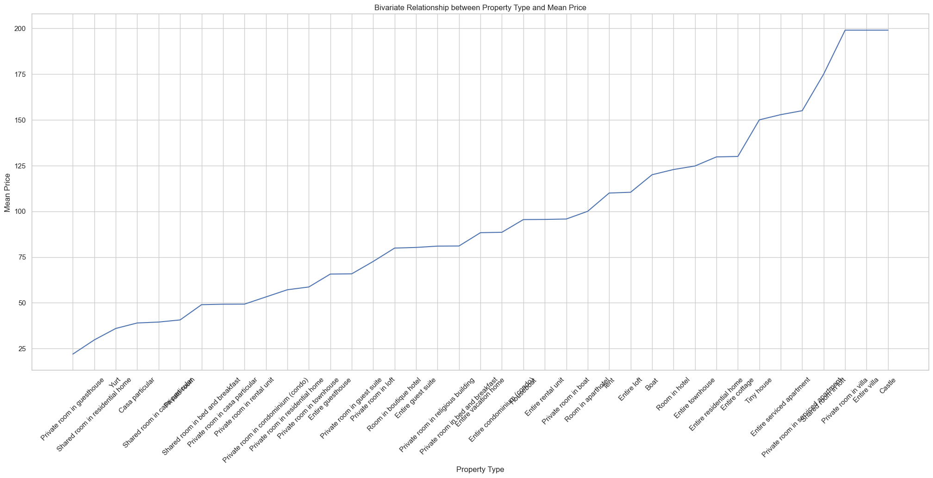
Task 2:Variable profiling and checking relationships between variables
Relationship between property_type and price
The plot shows the price varies according to the type of property. Hence we can say correlation exists between property_type and price.

Slide 14
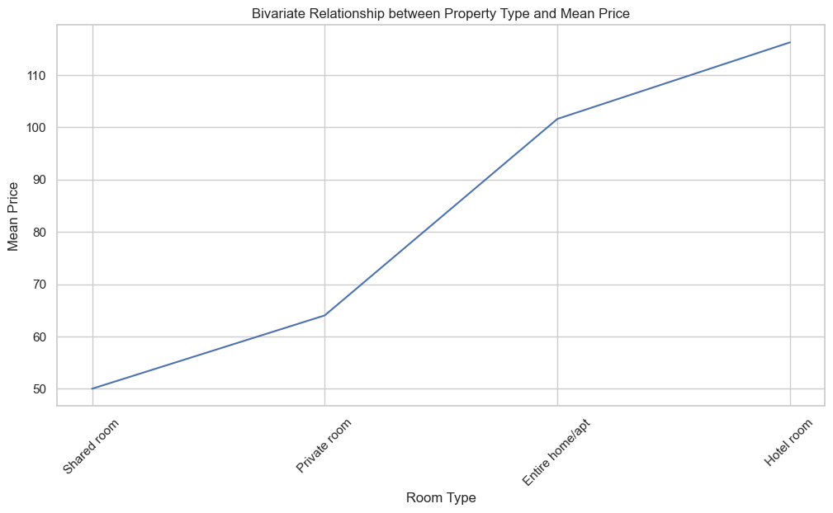
Task 2:Variable profiling and checking relationships between variables
Relationship between room_type and price
The plot shows the price varies according to the type of room. Hence we can say correlation exists between room_type and price.

Slide 15
Task 2:Variable profiling and checking relationships between variables
Relationship between listing_id and price
The correlation coefficient between the Listing_id and price is approximately 0.0085. The value is very close to 0, indicating that there is essentially no linear relationship between the Listing_id and price variables.
The p-value associated with the correlation coefficient is 0.4205. The high p-value suggests that there is insufficient evidence to reject the null hypothesis. Therefore, we do not have significant evidence to conclude that there is a statistically significant relationship between the Listing ID and price variables.
Conclusion: So from assessing the relationships between the predictor and target variables, it is decided to remove listing_id from modelling.

Slide 16
Task 2:Modelling – Test and Train split creation
Approaches:
Linear Regression Model, Regression Tree Model, Random Forest Regression, Gradient Boosting Machine (GBM) and Ridge Regression Model
Creating Test Train validation splits:
The main purpose of splitting the dataset into training and testing subsets is to evaluate the performance of the model on unseen data. The model is trained on the training subset and then evaluated on the testing subset.
X:- X represents the predictor variables or features used.(property_type, room_type, bedrooms, beds, accommodates)
Y:- Y represents the target variable that needs to be predicted.(price)
Test size:- the proportion of dataset to be allocated as testing subset. 0.2 or 20 percent is selected in this analysis. The remaining 80 percent will be used for training the model.
Random state:- By setting a specific random state , the train test split will generate same splits each time the code run, which ensures the reproducibility of result.

Slide 17
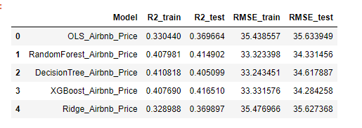
Task 2:Modelling – Metrics Comparison
Different regression models are run on the dataset and below is a comparison matrix of the observations/outcomes.

Slide 18
Task 2:Modelling – Selecting the Model
To select the model, the metrics (R-squared and Root Mean Squared Error) values are compared. The standard procedure is to select the model with high R- squared value and low RMSE value.
If the above practice is followed, Decision Tree Regression has the highest R-squared and lowest RMSE value. But it seems to overfit more on training data compared to others and it could potentially limit its performance on unseen data.
But Linear regression (OLS) is the model providing us the coefficients which help us to predict the price directly. For selecting the best model, it's essential to consider the context of the problem and the specific requirements of the application. Considering these two important factors, Linear Regression model is selected

Slide 19
Task 2:Modelling – Selecting the Model
To select the model, the metrics (R-squared and Root Mean Squared Error) values are compared. The standard procedure is to select the model with high R- squared value and low RMSE value.
If the above practice is followed, Decision Tree Regression has the highest R-squared and lowest RMSE value. But it seems to overfit more on training data compared to others and it could potentially limit its performance on unseen data.
But Linear regression (OLS) is the model providing us the coefficients which help us to predict the price directly. For selecting the best model, it's essential to consider the context of the problem and the specific requirements of the application. Considering these two important factors, Linear Regression model is selected

Slide 20
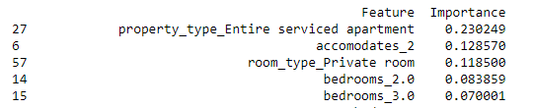
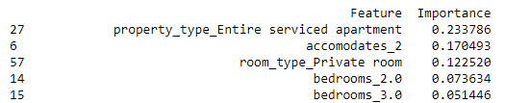
Task 2:Modelling – Selecting the Model
The importance of predictors can be determined by the measure of feature importance provided by models like Random Forest and Decision Tree. This is an indication of contribution of each predictor variable to model’s predictive performance.
So from feature importance scores, the top 5 important features are property_type_Entire serviced apartment, accommodates_2, room_type_Private room, bedrooms_2.0, bedrooms_3.0. Both Random forest and Decision Tree models are providing the same features. (Refer below Fig 1 and 2)
If we have to consider the predictor variables, then top 5 predictor variables are property_type, accommodates, room_type, bedrooms and beds.
From the importance scores, we can see that these features are having a positive impact on the response variable. It means that higher values of that predictor are associated with higher values of the response variable.
Fig 1: Random Forest Model
Fig 2: Decision Tree Model

Slide 21
Conclusion
Developed a machine learning-based solution to assist property owners in Antwerp, Belgium, in pricing their AirBnb rental properties.
The selected Linear Regression model provides accurate pricing suggestions and offers insights into the factors influencing property prices.
Future enhancements and model refinements are recommended to improve predictive accuracy.

Slide 22
Conclusion
Developed a machine learning-based solution to assist property owners in Antwerp, Belgium, in pricing their AirBnb rental properties.
The selected Linear Regression model provides accurate pricing suggestions and offers insights into the factors influencing property prices.
Future enhancements and model refinements are recommended to improve predictive accuracy.
THANK YOU!!

